Slide 1
Data Science Project
By - Satendra Kumar

Slide 2
Personal Information
Name: Satendra Kumar
Occupation: Software Engineer(Full Stack Developer)
Experience: 3 Years
Current Company: Tech Mahindra
Contact No: +91-8285336172
E-mail Id: satendrathakur772@gmail.com

Slide 3
Domain: Food & Beverages Topic of project: Wine Quality Data

Slide 4
Introduction
In this project, we will analyse the Red Wine Data and try to understand which variables are responsible for the quality of the wine.
First we will try to get a feel of the variables on their own and then we will try to find out the correlation between them and the Wine Quality with other factors thrown in.
We will implement Data Science with python to get the results and come out with some understanding.
So lets get started…

Slide 5
Dataset description
The data set is related to different attributes of red wine.
Input variables (based on physicochemical tests)
1 - fixed acidity 2 - volatile acidity
3 - citric acid 4 - residual sugar
5 - chlorides 6 - free sulfur dioxide
7 - total sulfur dioxide 8 - density
9 - pH 10 - sulphates
11 - alcohol
Output variable (based on sensory data)
12 - quality (score between 0 and 10)

Slide 6
Business questions identified

Slide 7
Question 1
What are the variable characteristics and observations(Univariate Analysis).

Slide 8
Approach
First we have cleaned the raw data and got some information about the same.
Then we plotted histograms for each variable to get idea about its distribution and skewness.
We had a tight observation on the outliers to observe the data better.

Slide 9
Findings & Visualizations

Slide 10
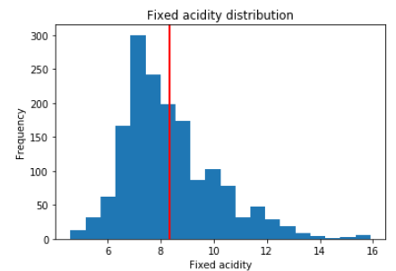
Fixed acidity distribution
The histogram a little right-skewed distributed with some outliers located at right side. The most frequent values are between 7-8. IQR is 2.1.

Slide 11
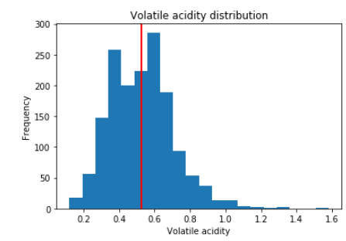
Volatile acidity distribution
The histogram is right-skewed distributed with some outliers located at right side. The most frequent values are between 0.4-0.6.

Slide 12
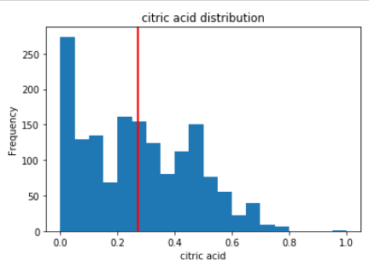
citric acid distribution
“citric acid” is right-skewed distributed with some outliers located at very right side. The most frequent values 0. It’s also interesting a lot of wine have citric acid = 0.

Slide 13
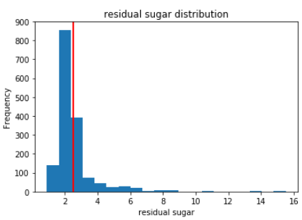
Residual sugar distribution
“residual sugar” is right-skewed distributed with a lot of outliers located at right side and a little bit at left side. The most frequent values are between 1.9-2.4. However, the maximum is locate too far away from 3rd quantile.

Slide 14
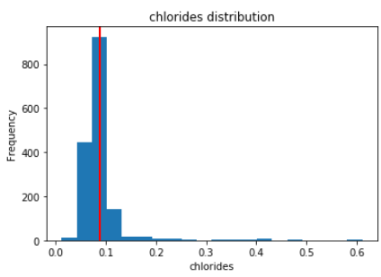
Chlorides distribution
“chlorides” is right-skewed distributed with a lot of outliers located at right side. The most frequent values are between 0.062-0.112.

Slide 15
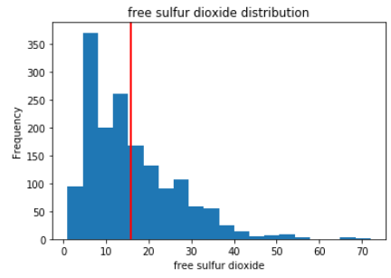
Free sulfur dioxide distribution
“free sulfur dioxide” is right-skewed distributed with a lot of outliers located at right side. The most frequent values are between 5-15.

Slide 16
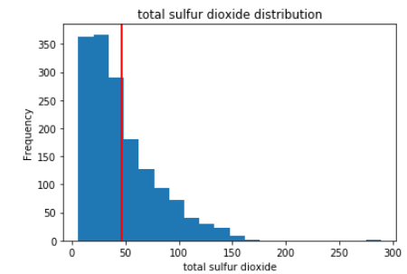
Total sulfur dioxide distribution
“total sulfur dioxide” is right-skewed distributed with some outliers located at right side. The most frequent values are between 10-45.

Slide 17
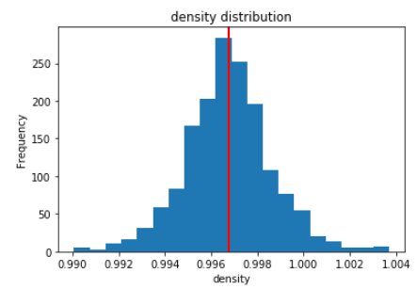
Density distribution
“density” is approximately symmetric, and it’s surprising the difference among different wines, though they might test significantly different, are not that big.

Slide 18
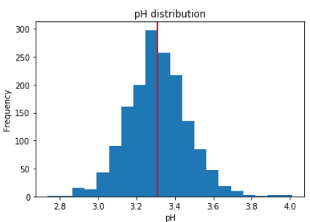
pH distribution
“pH” is almost symmetric. The most frequent value is between 3.24 and 3.44. It’s not a big difference.

Slide 19
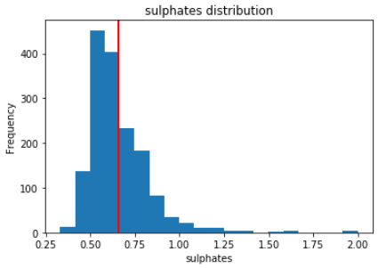
Sulphates distribution
“sulphates” is a little bit right-skewed distributed with some outliers located at right side. The most frequent values are between 0.5-0.7.

Slide 20
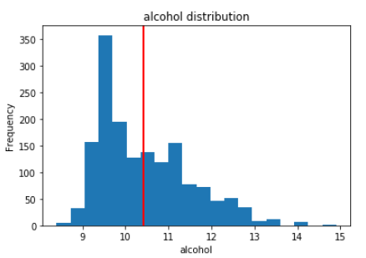
Alcohol distribution
“alcohol” is right-skewed distributed with some outliers located at right side. The most frequent values are between 9.4-9.6.

Slide 21
Question 2
Is their any correlation between the different attributes.

Slide 22
Approach
We plotted a scatter matrix to see the relationship between the attributes.
Then we plotted the heat-map to observe the correlation closely.

Slide 23
Findings & Visualizations

Slide 24
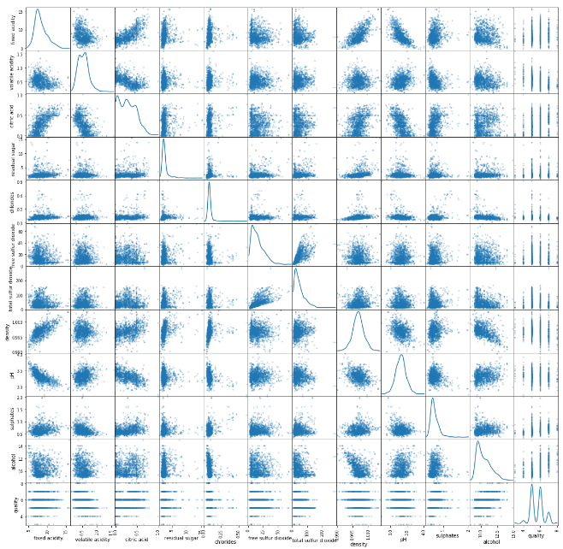
Bivariate Analysis(Scatter Mattrix)
From the scatterplot we can get some interesting details. For some of the features, the distribution appears to be fairly linear. For some others, the distribution appears to be negatively skewed. So this confirms our initial suspicions — there are indeed some interesting co-dependencies between some of the features.

Slide 25
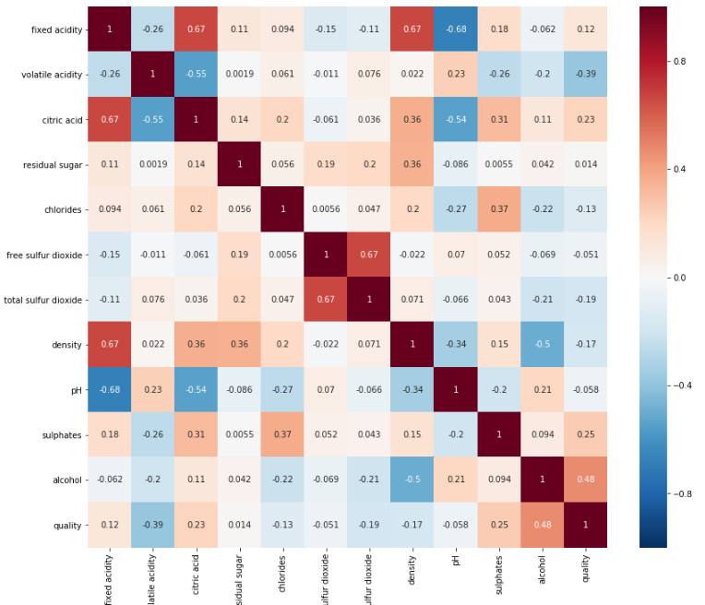
Bivariate Analysis(Heatmap)
As you can see, the squares with positive values show direct co-relationships between features. The higher the values, the stronger these relationships are — they’ll be more reddish. That means, if one feature increases, the other one also tends to increase, and vice-versa.
The squares that have negative values show an inverse co-relationship. The more negative these values get, the more inversely proportional they are, and they’ll be more blue. This means that if the value of one feature is higher, the value of the other one gets lower.
For example, citric acidity associates positively with fixed acidity, while pH negatively associates with fixed acidity. However, there seems no attributes have strong correlation with quality.
Finally, squares close to zero indicate almost no co-dependency between those sets of features.

Slide 26
Question 3
How the Quality of wine is distributed and how we can categorize the data according to its quality.

Slide 27
Approach
First we have cleaned the raw data and got some information about the same.
Then we plotted histograms for quality of wine and the count of it, so that we can have idea about the actual distribution.
Then we classified the quality of wine in 3 categories as Good, Average and Bad.
We calculated the actual count for each category and plotted a histogram for categorized quality of wine and the quantity of collected wine.

Slide 28
Findings & Visualizations

Slide 29
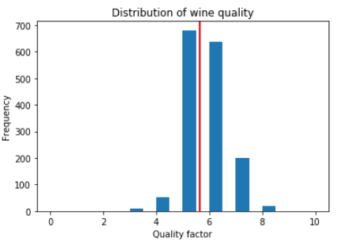
Distribution of wine quality
About 82 observations get 5-6 ratings, while only 14 (227 counts) got 3,7 or 8 scores on quality rating. Now let’s check quality by dividing them into 3 groups: "Bad"(3-4), "Average"(5-6), "Good"(7-8)

Slide 30
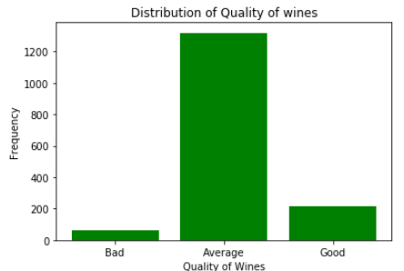
Distribution of Categorized wine Quality
The moderate(Avg) quality wines takes up most part and we have much less data on low/high quality wines, which might produce some bias in this analysis. But we hope that the data is reliable and trustworthy.

Slide 31
Question 4
How these Attributes affecting quality of wine(Bivariate Analysis).

Slide 32
Approach
We grouped the data according to the quality of wine.
Then we plotted bar-plots for quality of wine and each attribute to get more idea that how individual attributes affecting the quality of wine.

Slide 33
Findings & Visualizations

Slide 34
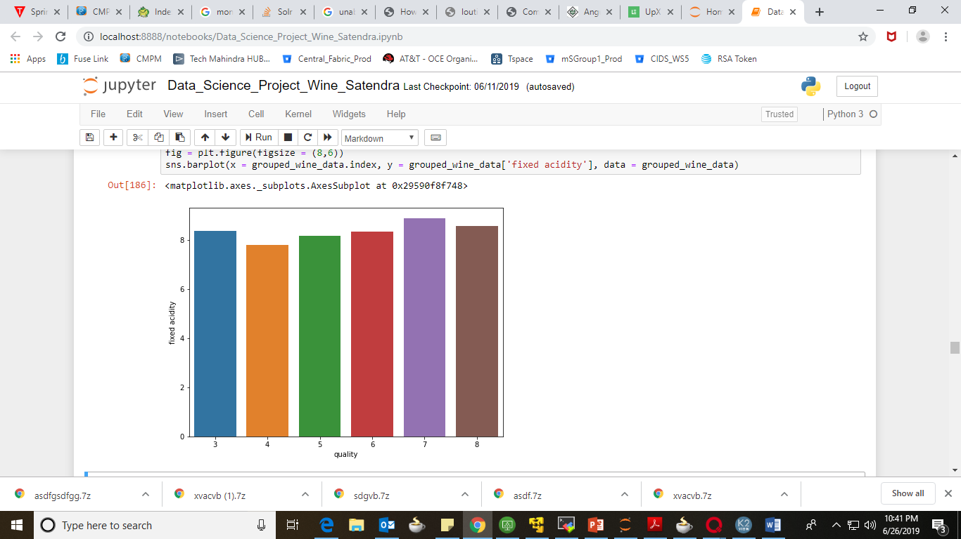
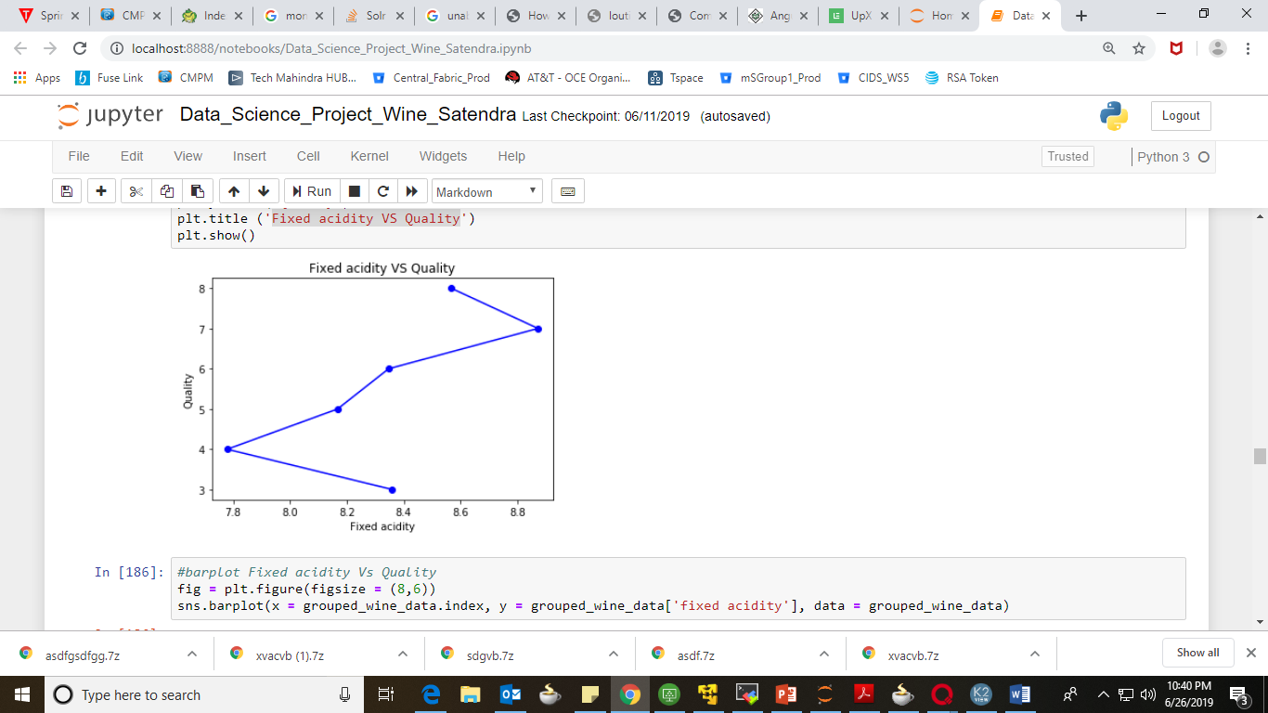
Fixed acidity VS Quality
As we can see, Fixed Acidity has almost no effect on the Quality. The values are random and no pattern is found between them to conclude the relation.

Slide 35
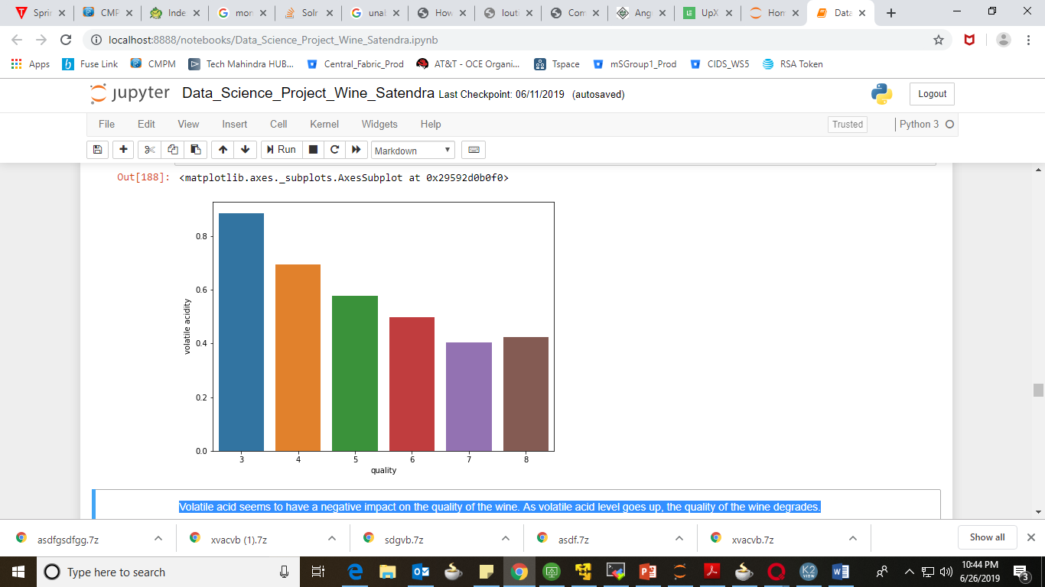
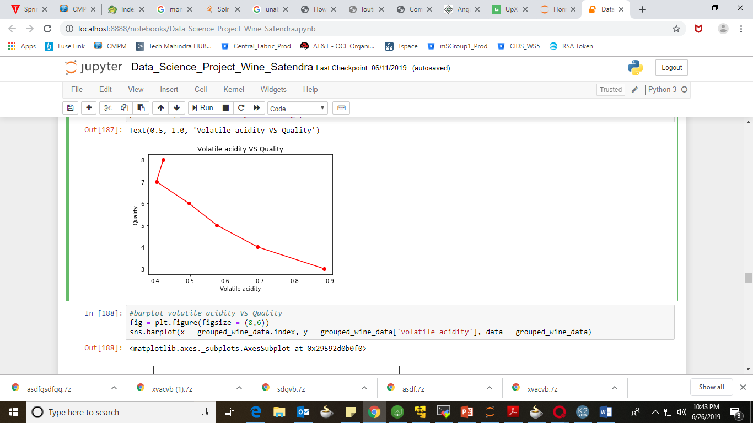
Volatile acidity VS Quality
Volatile acid seems to have a negative impact on the quality of the wine. As volatile acid level goes up, the quality of the wine degrades.

Slide 36
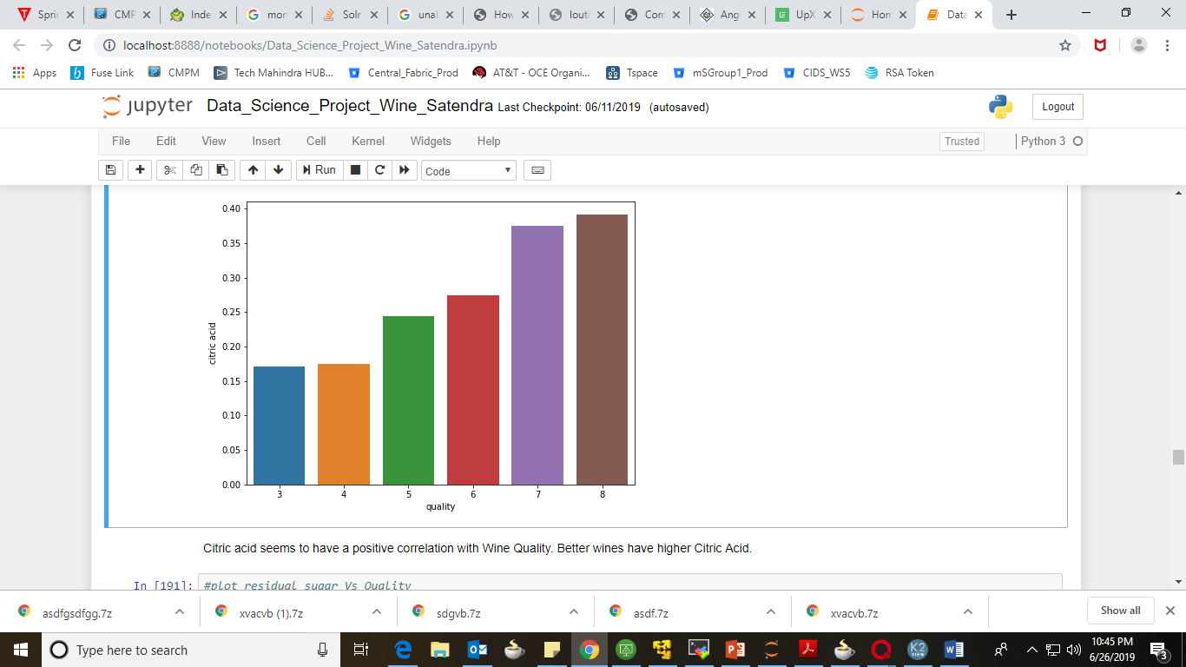
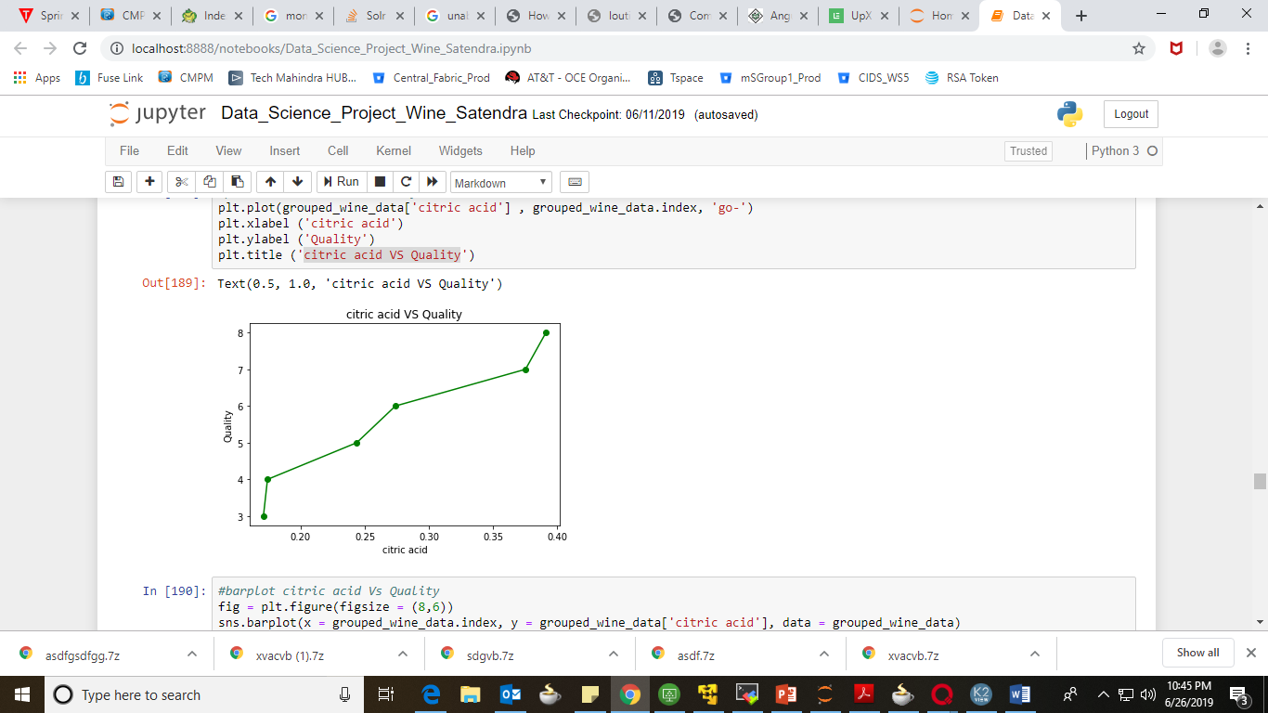
Citric acid VS Quality
Citric acid seems to have a positive correlation with Wine Quality. Better wines have higher Citric Acid.

Slide 37
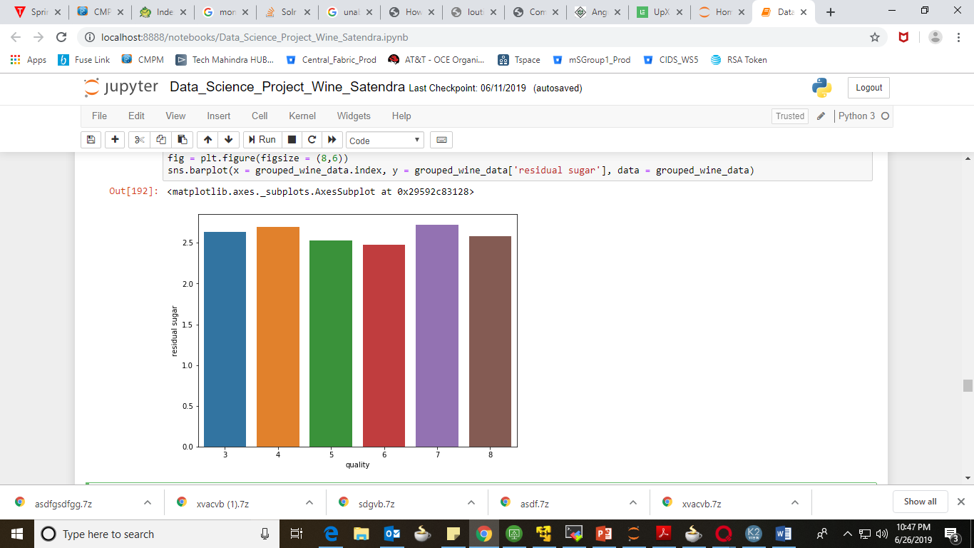
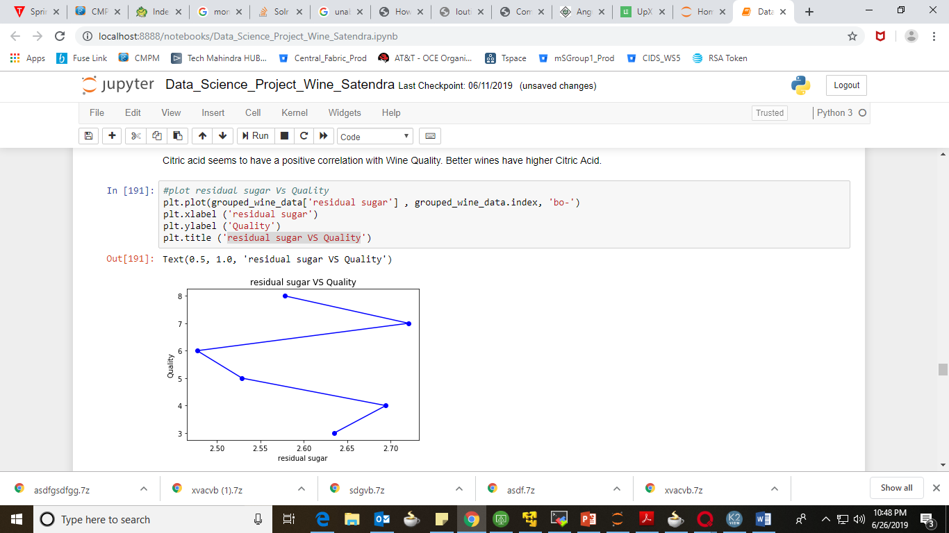
Residual sugar VS Quality
As we can see, Residual Sugar almost has no effect on the Quality of the Wine.

Slide 38
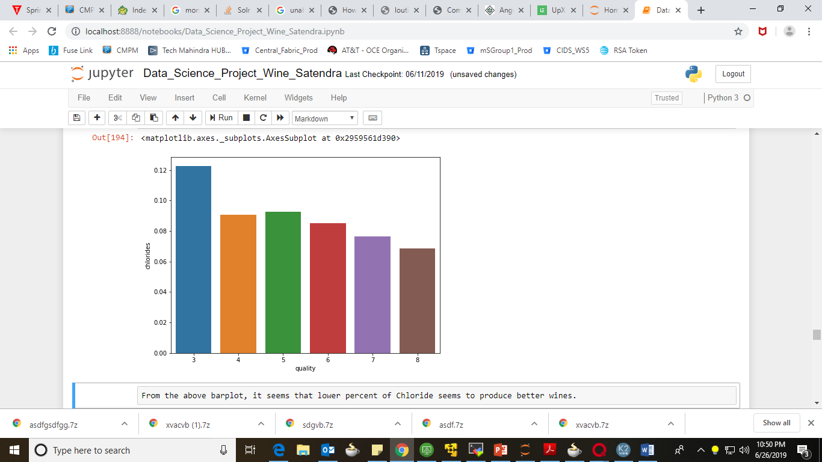
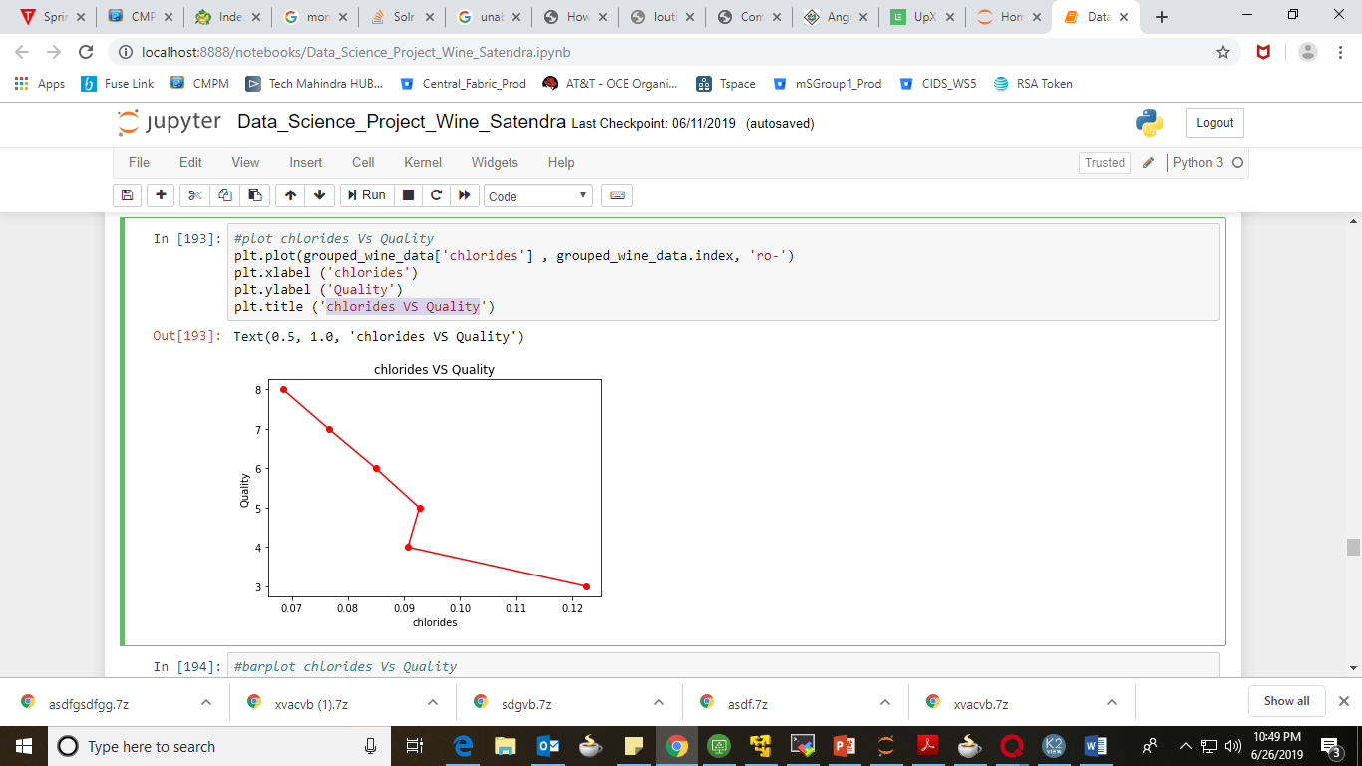
Chlorides VS Quality
From the above bar-plot, it seems that lower percent of Chloride seems to produce better wines.

Slide 39
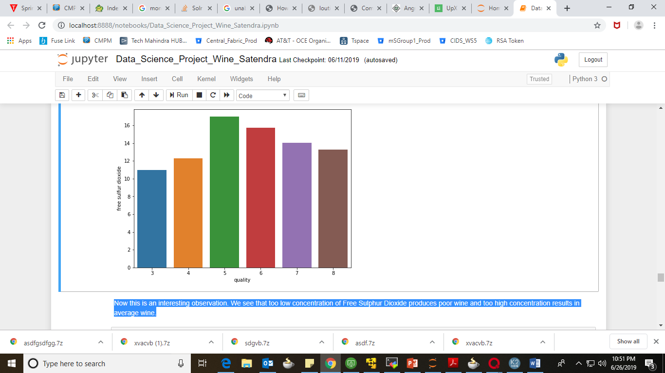
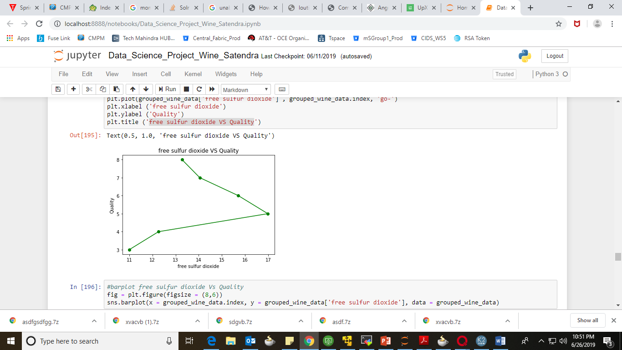
Free sulfur dioxide VS Quality
Now this is an interesting observation. We see that too low concentration of Free Sulfur Dioxide produces poor wine and too high concentration results in average wine.

Slide 40
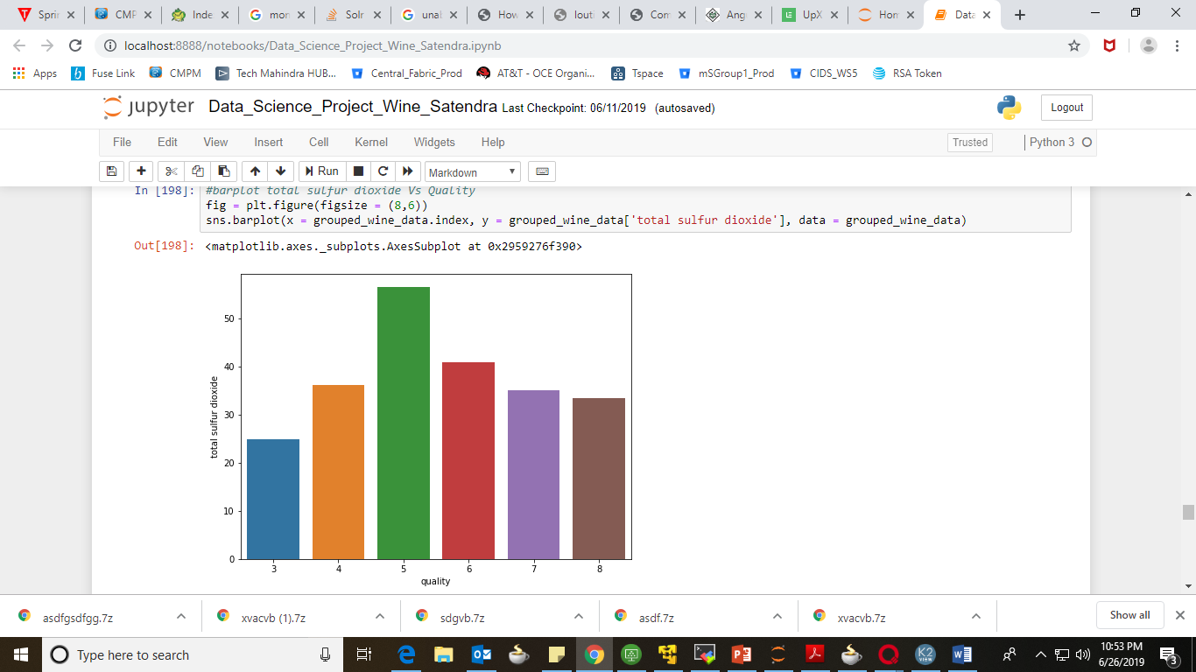
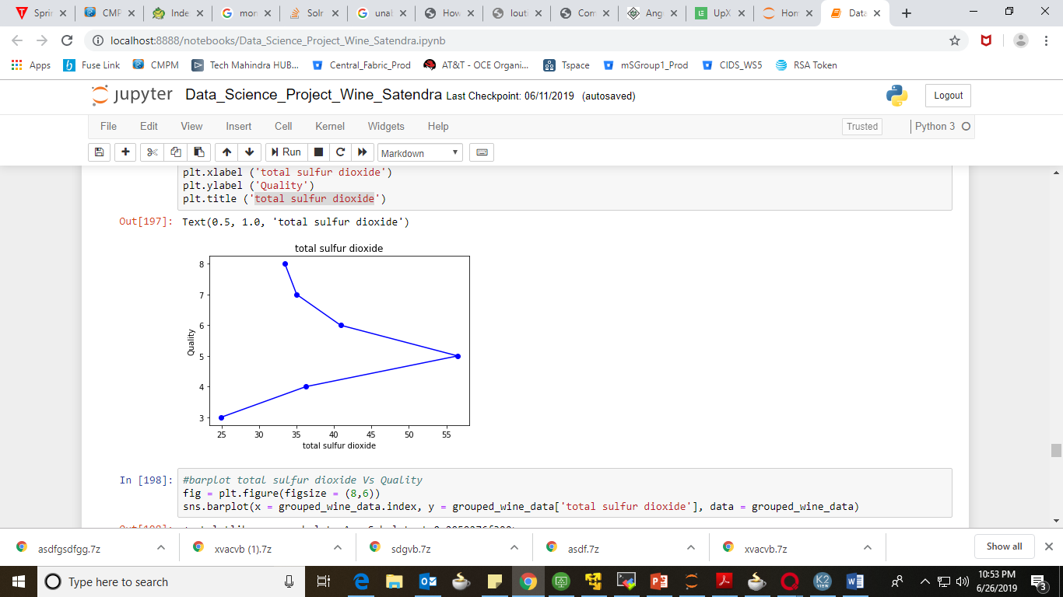
Total sulfur dioxide
As this is a Subset of Free Sulfur Dioxide, we see a similar pattern here.

Slide 41
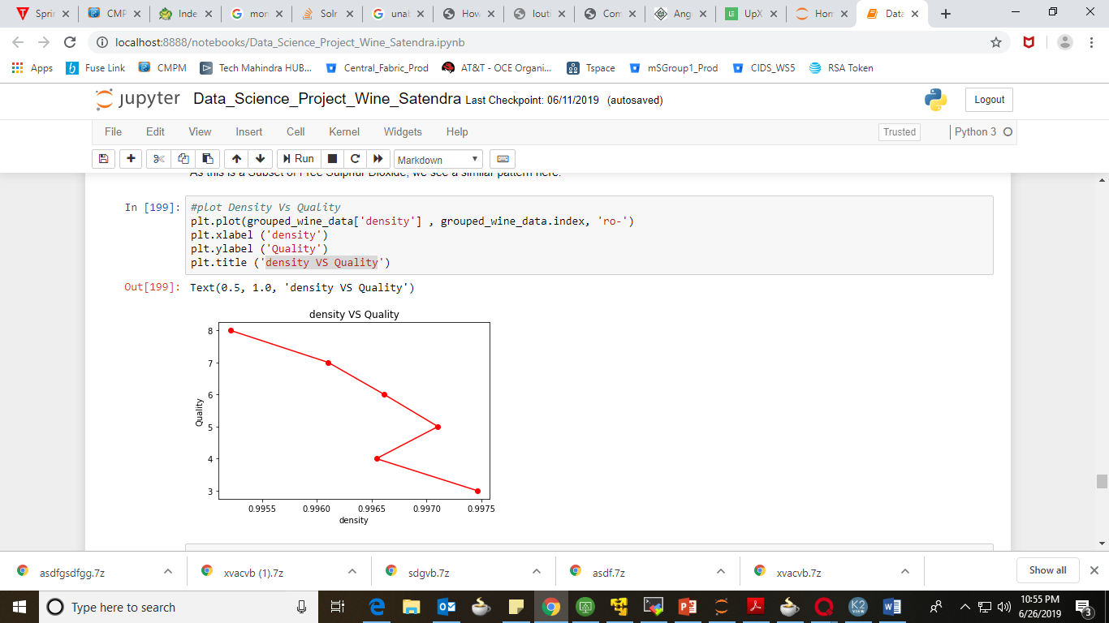
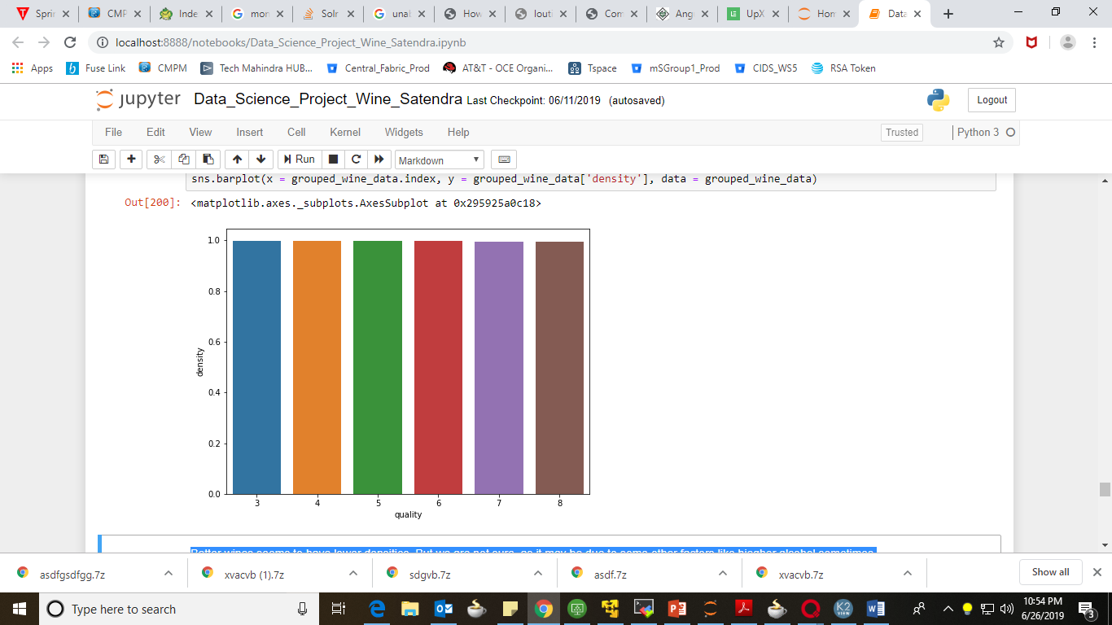
Density VS Quality
Better wines seems to have lower densities. But we are not sure, as it may be due to some other factors like higher alcohol sometimes.

Slide 42
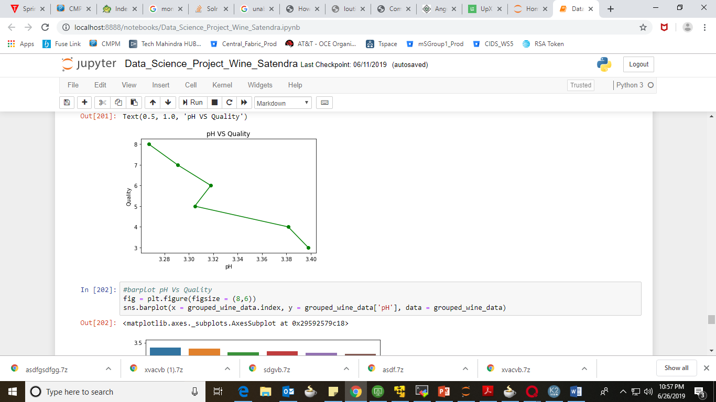
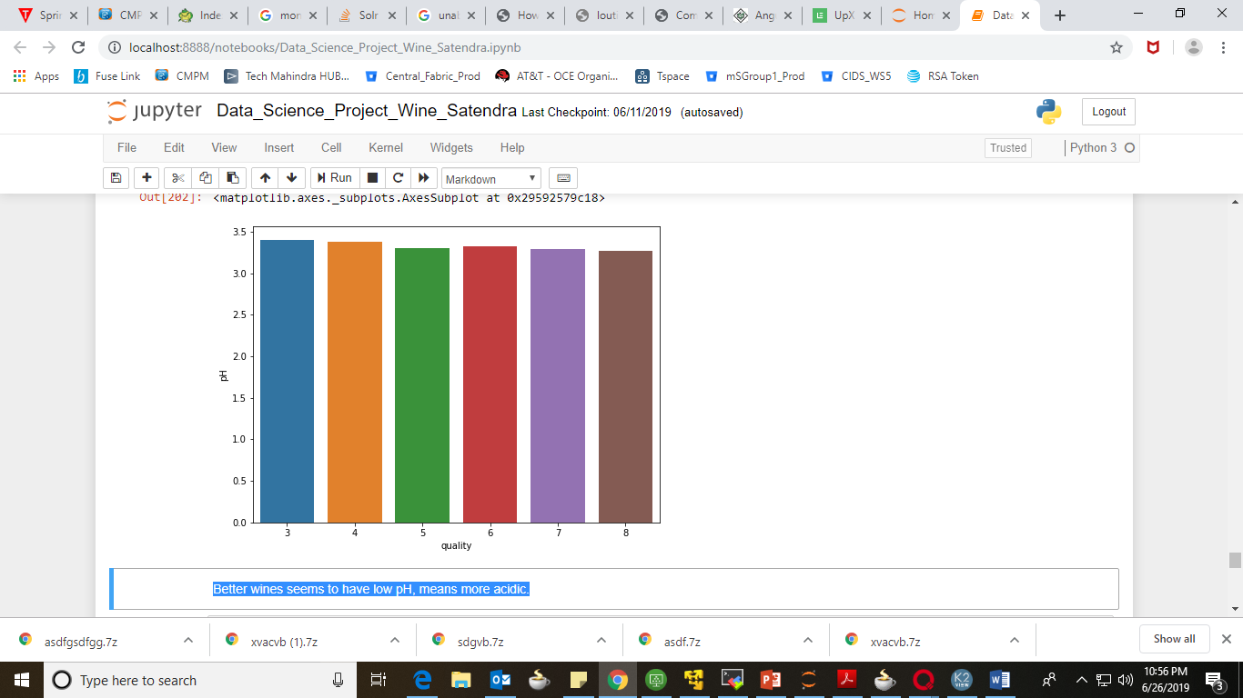
pH VS Quality
Better wines seems to have low pH, means more acidic.

Slide 43
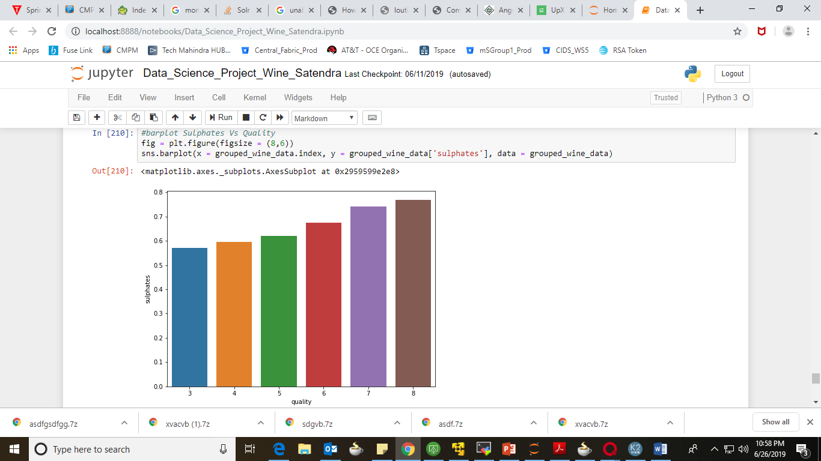
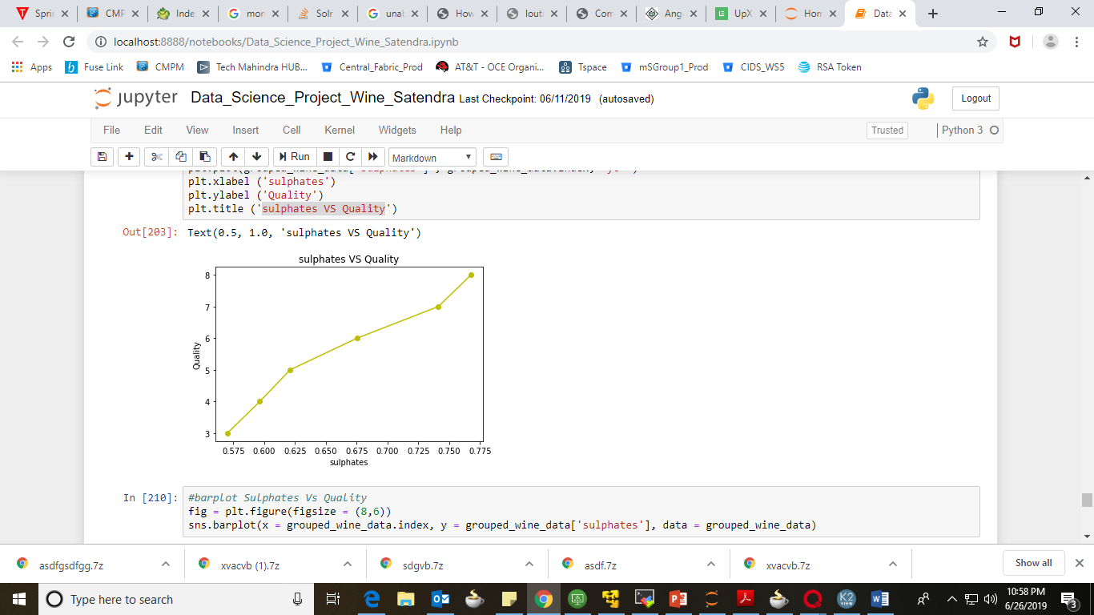
Sulfates VS Quality
From the above bar-plot, we can see higher the sulphates level better will be the wine.

Slide 44
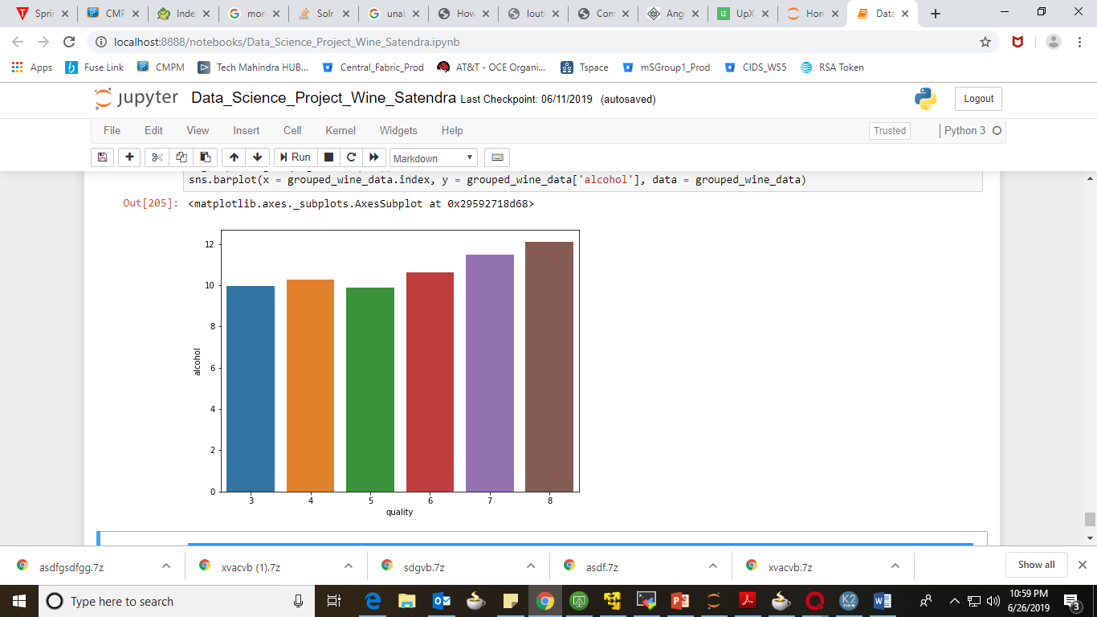
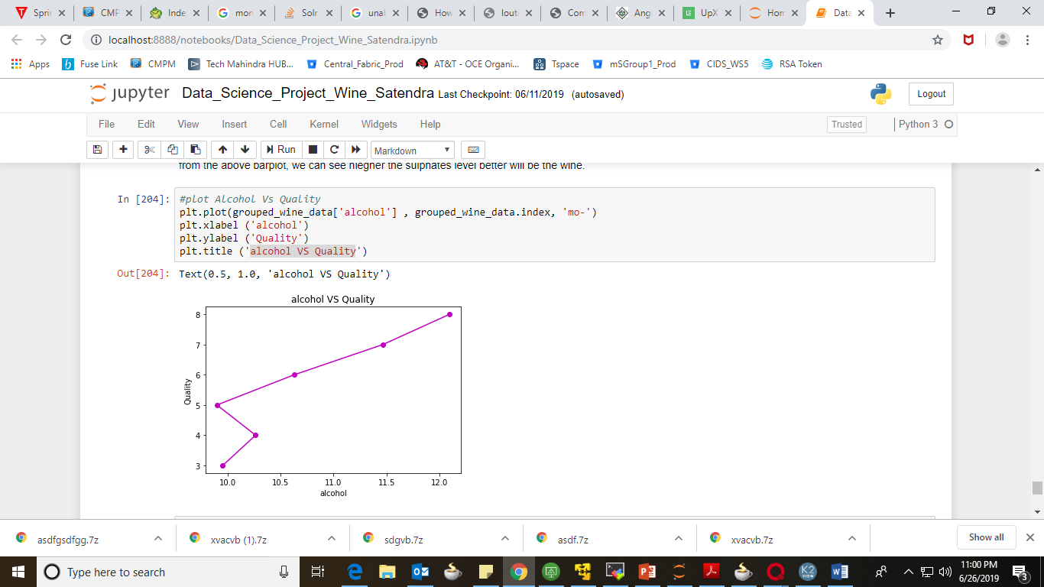
Alcohol VS Quality
It seems like with the increase in alcohol level, the quality of wine gets better. But we can't be so sure as there is some strange behaviour for 4 and 5. So, that may be due to some other factors.

Slide 45
Question 5
Characteristics that can influence wine quality positively.

Slide 46
Approach
We grouped the data according to the quality of wine.
Then we plotted bar-plots for quality of wine and each attribute to get more idea that how individual attributes affecting the quality of wine.
Then we observe the plots carefully and listed down the characteristics which influencing the wine quality positively.

Slide 47
Findings

Slide 48
Good Wine Characteristics
volatile acidity is low
Citric acid is high
Chlorides is low
Density is low
pH is low
Sulphates is high
Alcohol level is high

Slide 49
Question 6
Characteristics that can influence wine quality Negatively.

Slide 50
Approach
We grouped the data according to the quality of wine.
Then we plotted bar-plots for quality of wine and each attribute to get more idea that how individual attributes affecting the quality of wine.
Then we observe the plots carefully and listed down the characteristics which influencing the wine quality negatively.

Slide 51
Findings

Slide 52
Bad Wine Characteristics
volatile acidity is High
Citric acid is low
Chlorides is high
Density is high
pH is high
Sulphates is low
Alcohol level is low

Slide 53
Thankyou!

